Slide 1

Demonstrating the value of Destination Earth through its DestinE Platform and tailoring its evolution on real user needs

Slide 2




DEUC in a nutshell
Main activities
Use cases to demonstrate the impact of the Destination Earth Service Platform (DESP) and DestinE infrastructure.
Community building to co-design the DESP to ensure that it responds to real user needs.
Develop & maintain the Joint DestinE Website
Entrusted Entity
Coordinator
Partners
Duration: Feb. 2023 – Jul. 2024

Slide 3
Use Cases
Feb’23: Project Kick-off
18 Apr’23: Round 1 Tender opened
Sep’23: Round 1 Use Cases Kick-off
Q1 2024: Round #2 Tender foreseen
Jun 2024: Project End
6 Jun’23: Round 1 Tender closed
Q1 2024: Round #2 Use Cases KO foreseen
Duration: max 1 year
Budget: max €500K per use case
Use Case Features
Demonstrate the value added by DestinE, and DESP in particular at providing actionable information and decision support on themes linked to the Green Transition and Digital transformation
Make use of DestinE Platform and DestinE specific data
Based on operational or pre-operational software
No overlap with use cases already procured by other EE
Support co-development and co-design from the relevant community
End User(s) are part of the project consortium
Roadmap

Slide 4
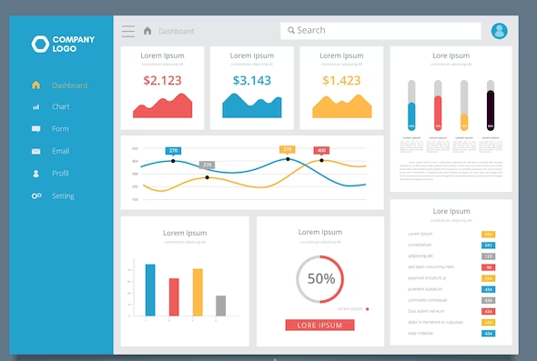
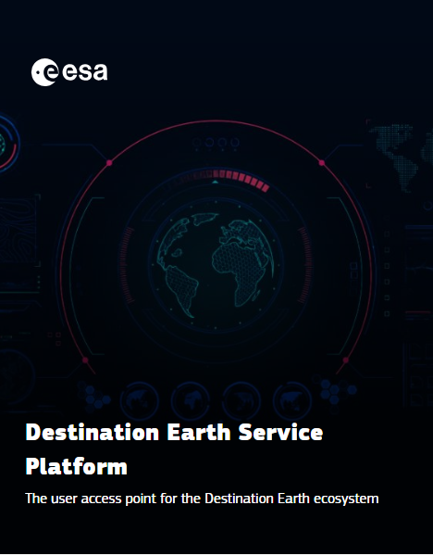
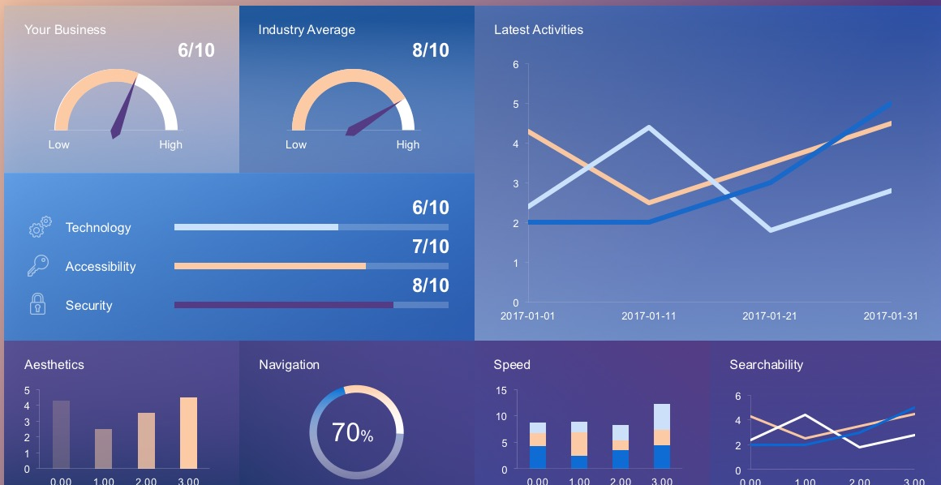
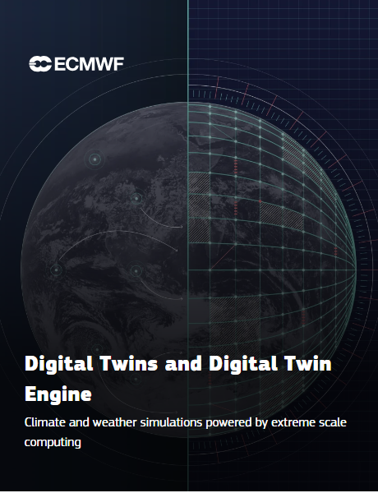
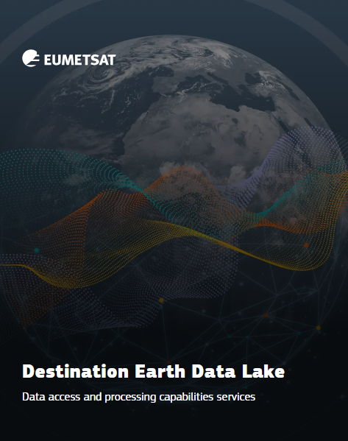

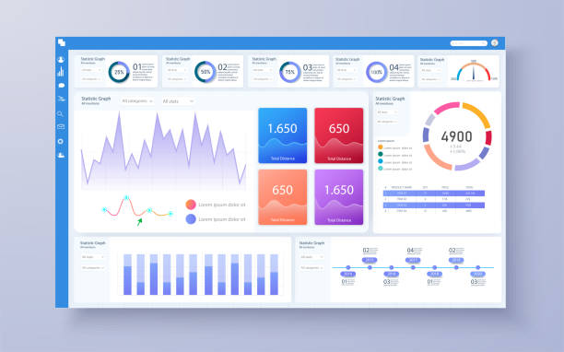
DestinE Platform Use Cases conceptual view
Federated Use Case
Federated Use Case
Integrated UC

Slide 5
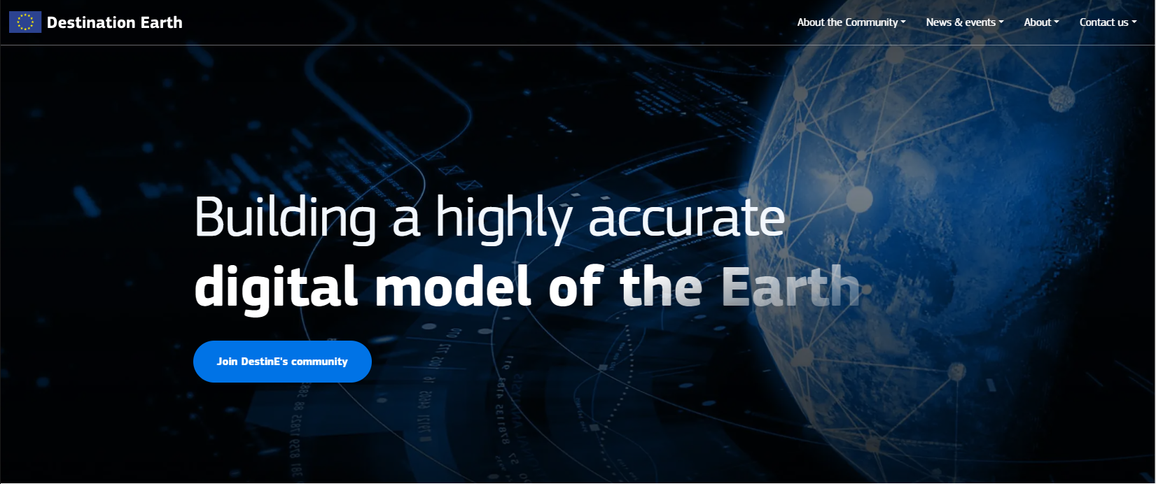
Joint Website
3 Entrusted Entities implementing the Destination Earth initiative and the European Commission have agreed to evolve what would have been the DestinE Community Portal into the DestinE Joint Website.
The website aims to be a gathering point and inform audiences interested in DestinE on the latest developments and co-development opportunities.
The DestinE Joint Website has an editorial board made up of representatives of the entities and the EC and is implemented by resources from the ESA DestinE Platform Use Cases project (RHEA, Trust-IT, and AUTh).
www.destination-earth.eu
News
Events incl. DestinE User eXchanges
DestinE Journal (insider interviews)
Procurement
Use cases
Community
DestinE Platform user access point
Related pan-EU & national initiatives

Slide 6
DestinE Community Building
Policy makers
Decision makers
Research & academia
Technology providers
Industry
General public
DEUC will undertake community building activities for DestinE.
Vision: Build a community that will guide the development and sustainability of DestinE.
DEUC foresees continuous interactions amongst users, developers, stakeholders and partners to develop, enhance and improve DestinE capabilities and establish cross-sectorial collaboration.

Slide 7
Join us! www.destination-earth.eu and learn about:
Challenges and Hackathons: Support the DESP innovation through ideas and proposals
Webinars: Engage directly with the DESP and use case developers
Workshops and Surveys: Provide requirements that will help shape functionalities

